Slide 1


Bankruptcy Prevention
Group 5
Project Mentor – Madishetti Rajashekar

Slide 2
Bankruptcy Definition
Bankruptcy is a legal proceeding initiated when a person or business is unable to repay outstanding debts or obligations.
▪ In case of bankruptcy, the debtor’s assets are measured and evaluated, where upon the assets are used to repay the outstanding debts.
Causes of Bankruptcy
▪ Outside business conditions: increase in competition, insurance and general costs of doing business.
▪ Financing: includes loss of capital, inability secure new capital and high debt.
▪ Inside business conditions: management mistakes, location, loss of clients and trade credit problems.
▪ Tax: problems with the tax authorities
▪ Disputes with creditor: foreclosures, lawsuits, and contract disputes.
▪ Calamities: fraud, theft, natural disasters and accidents.

Slide 3
Business Understanding:
Bankruptcy prediction, also named as corporate bankruptcy prediction or corporate failure prediction, has long been a significant topic in the field of accounting and finance, since the health of a firm is highly important to its creditors, investors, shareholders, partners, even its buyers and suppliers.
Bankruptcy is a state where a company is not able to run its business or continue its operation in the future because of its financial condition or debts. Any firm or investor needs to know the state of bankruptcy before they start investing in the company. Having a standardized approach looks like a generous idea in predicting any state but is very unlikely that the method will give satisfying results because of the real-world situations established.
Researchers and practitioners have been dedicated to developing methods and techniques to predict the bankruptcy of firms more quickly and more accurately.
Objective of the Analysis:
The goal of this project is to build a model that can predict Bankruptcy. The challenge behind Bankruptcy prediction in machine learning is that Bankruptcy samples are far less common as compared to Non-Bankruptcy.
Bankruptcy prediction is a challenging problem, given the variety of Bankruptcy patterns and relatively small ratio of known Bankruptcy in typical samples. While building prediction models, the savings from loss prevention needs to be balanced with the cost of false alerts. Machine learning techniques allow for improving predictive accuracy, enabling loss control units to achieve higher coverage with low false positive rates.
Using the given data, different types of machine learning models are built by varying different parameters in each type of model. The accuracy, recall and precision are checked for each model. The model which gives the best results is selected as our final model which clearly classifies whether a company goes Bankruptcy or not.

Slide 4
Problem Statement:
To predict if a company will file for bankruptcy or not
About Dataset:
Input variables:
The data file contains 7 features about 250 companies The data set includes the following variables:
1.industrial_risk : 0=low risk, 0.5=medium risk, 1=high risk.
2.management_risk : 0=low risk, 0.5=medium risk, 1=high risk.
3.financial flexibility : 0=low flexibility, 0.5=medium flexibility, 1=high flexibility.
4.credibility : 0=low credibility, 0.5=medium credibility, 1=high credibility.
5.competitiveness : 0=low competitiveness, 0.5=medium competitiveness, 1=high competitiveness.
6.operating_risk : 0=low risk, 0.5=medium risk, 1=high risk.
7.class : bankruptcy, non-bankruptcy (target variable).
Following are the details of the qualitative risk factors which mentions their risk components:
Industry risk : Government policies and International agreements, Cyclicality, Degree of competition, The price and stability of market supply, The size and growth of market demand, The sensitivity to changes in macroeconomic factors, Domestic and international competitive power, Product Life Cycle.
Management risk : Ability and competence of management, Stability of management, The relationship between management/ owner, Human resources management, Growth process/business performance, Short- & long-term business planning, achievement and feasibility.
Financial Flexibility : Direct financing, Indirect financing, Other financing
Credibility : Credit history, reliability of information, The relationship with financial institutes.
Competitiveness : Market position, The level of core capacities, Differentiated strategy,
Operating Risk (OP): The stability and diversity of procurement, The stability of transaction, The efficiency of production, The prospects for demand for product and service, Sales diversification, Sales price and settlement condition, Collection of A/R, Effectiveness of sale network.

Slide 5
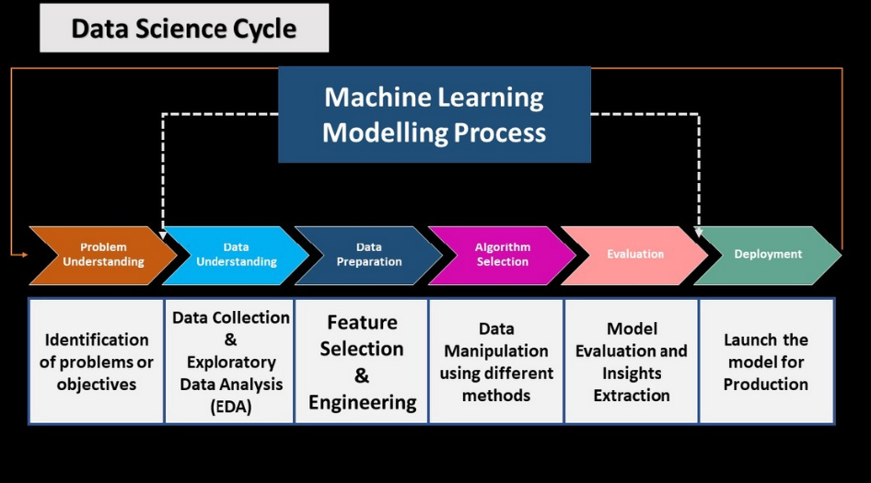
Project Workflow

Slide 6
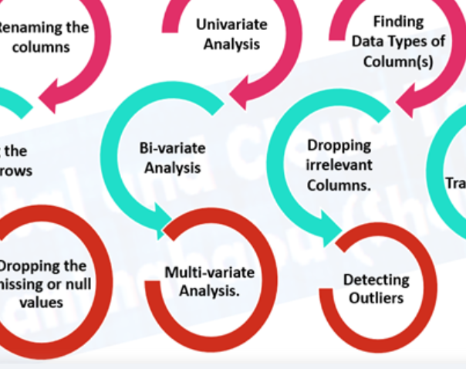
Exploratory Data Analysis (EDA) & Feature Engineering

Slide 7
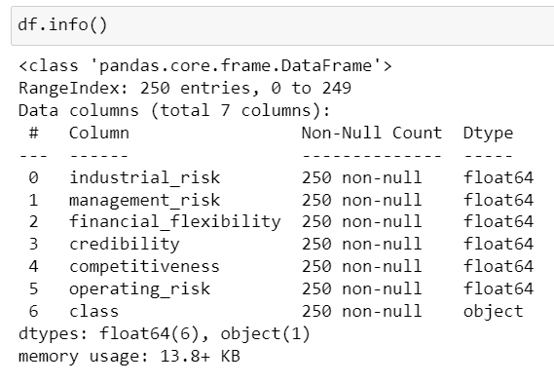
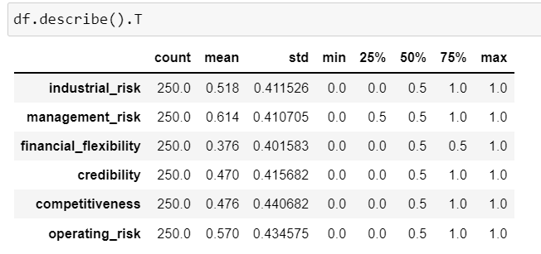
Data Set Analysis
The Data set includes the following variables:
Industrial risk
Management risk
Financial flexibility
Credibility
Competitiveness
Operating risk
Class

Slide 8
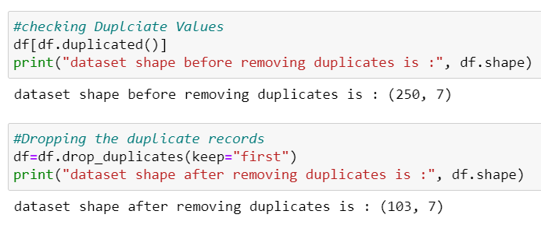
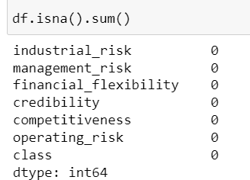
Inferences from Data Set
There are 250 records in the dataset, of which 147 are duplicates.
The data file contains seven features: six input variables and one output variable.
There are no null values in the Datafile.

Slide 9
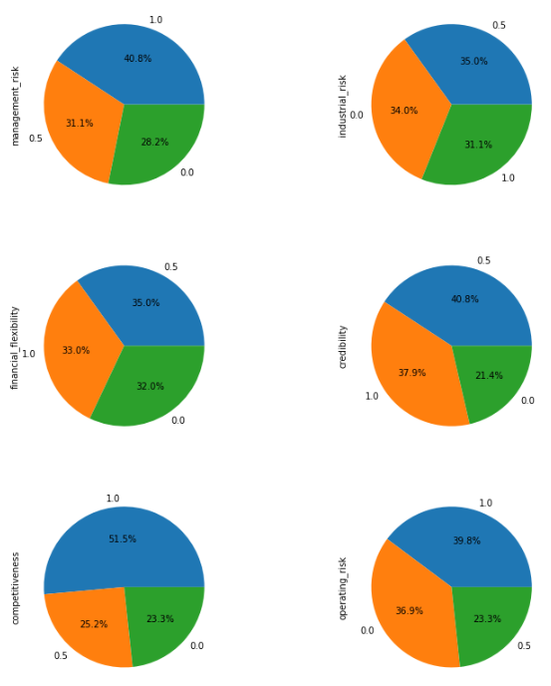
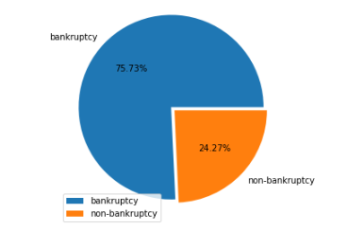
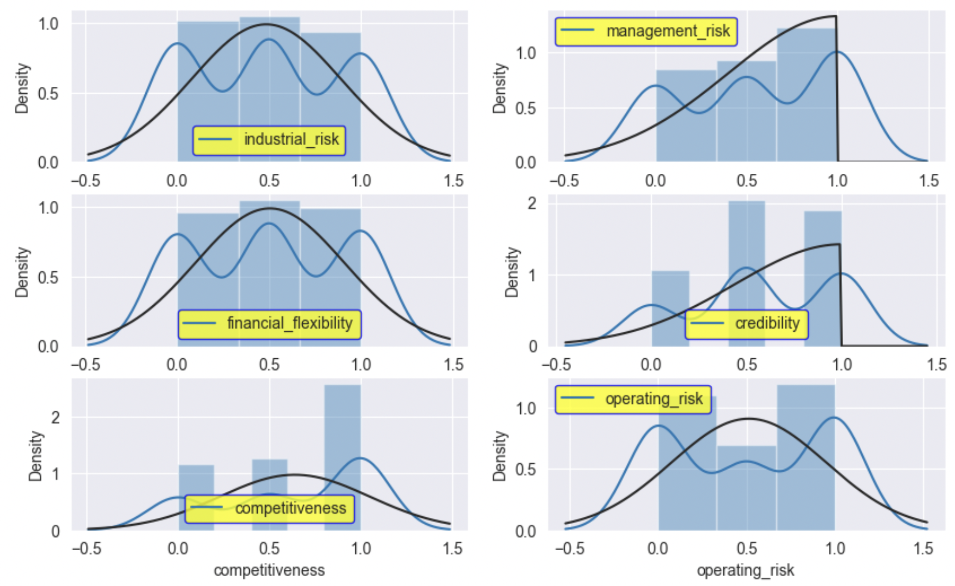
Visualization -Univariate Analysis
Target data Distribution
Pie sub-plots for dependent variables
Dist-plots for dependent variables
Observations:
The target variable is imbalanced even though the feature’s observed data apeears to be almost equally distributed between the given range of values (0, 0.5, 1)
From the distplot, it can be inferred that managemen_risk,credibility and competitiveness is notnormally distributed and skewed.

Slide 10
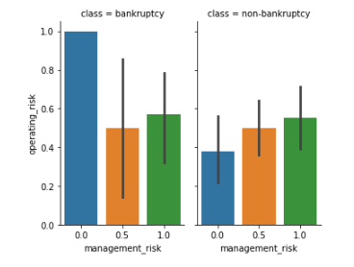
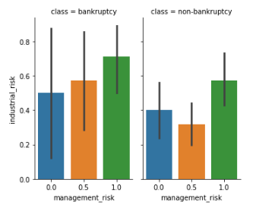
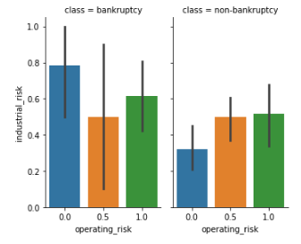
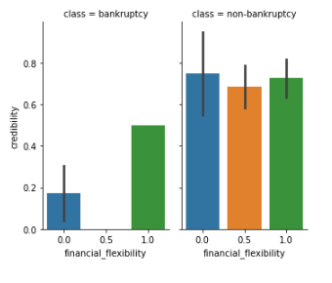
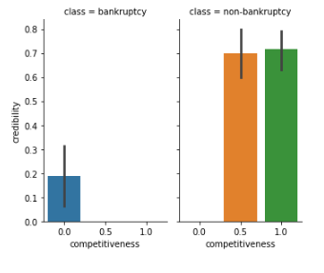
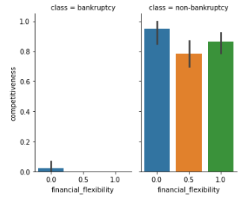
Visualization -Bivariate Analysis
Management Risk vs Industrial Risk
Operating Risk vs Industrial Risk
Bankruptcy Rate is high↑
Management Risk vs Operating Risk
High operation risk and low management risk
High Management and Industrial Risk
High industrial Risk and low operating risk
Financial flexibility vs Credibility
Competitiveness vs Credibility
Financial flexibility vs Competitiveness
low credibility and low financial flexibility
low credibility and low competitiveness
low competitiveness Risk and low financial flexibility

Slide 11
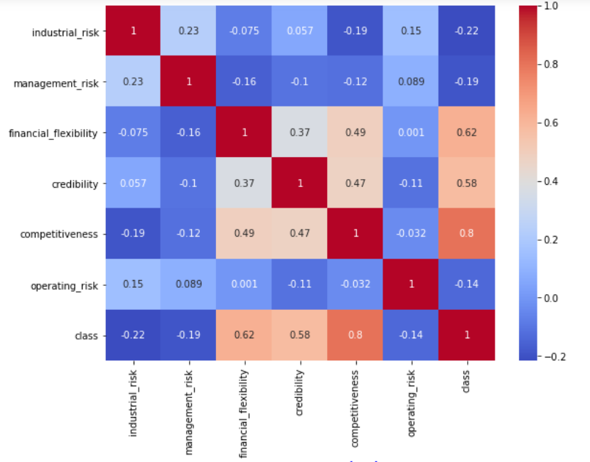
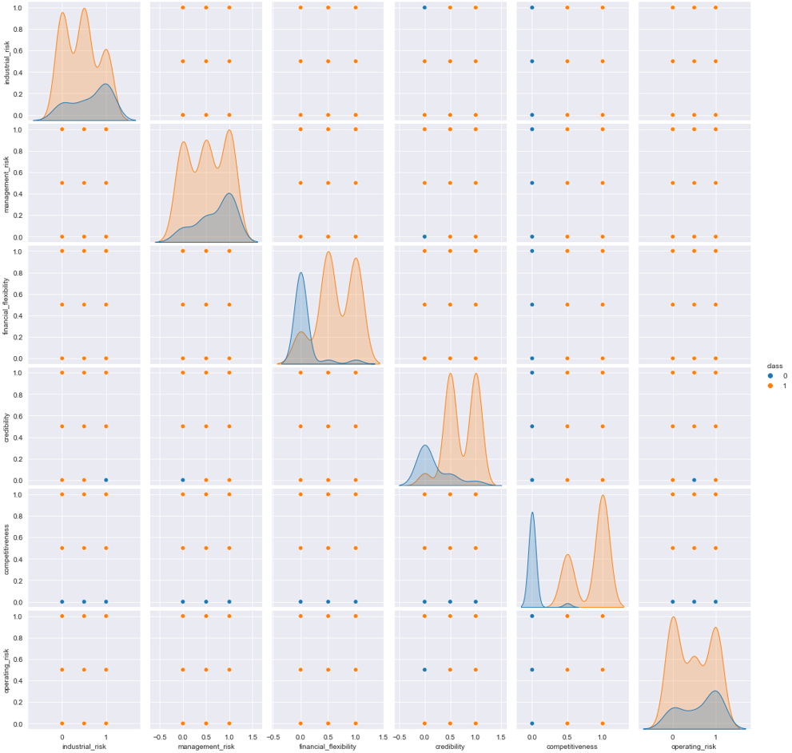
Visualization -Multivariate Analysis
Correlation
Pair plot
we can see financial flexibility, competitiveness and credibility is above the threshold value of 0.5 is strongly correlated with the target variable(class)

Slide 12
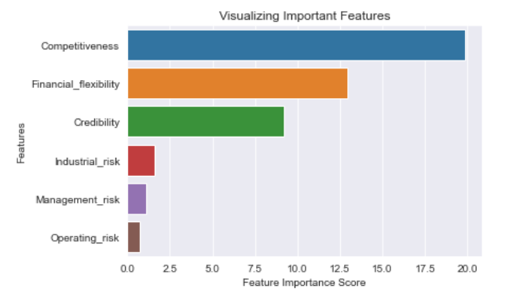
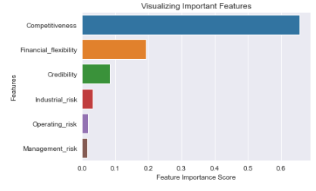
Feature Importance Score
Feature selection Technique -Chi Square
Feature selection Technique –Random Forest
Extracted the feature important score to visualize the most and least important feautes.
NB: The provided dataset has less number of rows, The consent was not to remove any features from the dataset.

Slide 13
Feature Engineering
We can see the o/p data is not balanced, so either we could balance the data and check the accuracy score, or we could keep the data as it is and check the precision and recall score. We will use balancing techniques as well as raw data (imbalanced data) to build a model and infer features as part of feature engineering.
Under sampling Random
Oversampling SMOTE
SVMSMOTE
K Means SmoteSMOTEENN
Mix of under sample & oversample
Oversampling Random

Slide 14

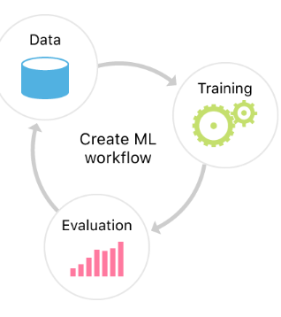
Model Building

Slide 15
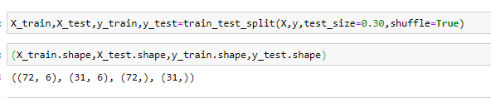
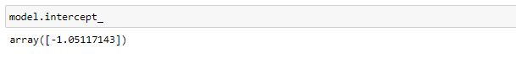
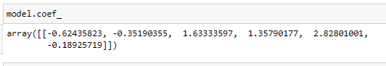
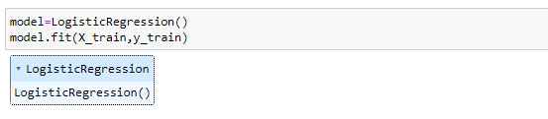
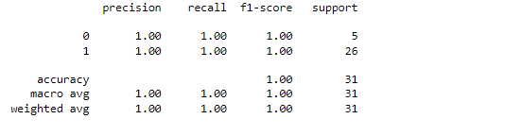
Model 1 –Logistic Regression (RAW Data)
Data split
Model Evaluation Parameters
Model Algorithm
Classification Report

Slide 16
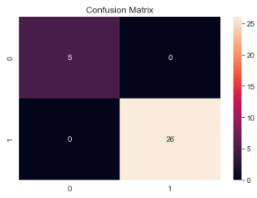
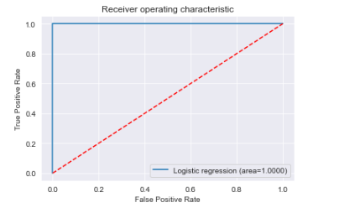
Model 1 –Logistic Regression
Confusion Matrix
ROC & AUC curve for the model

Slide 17
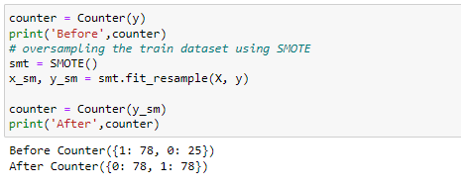
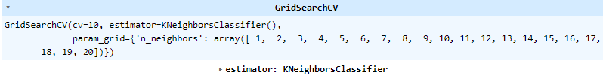
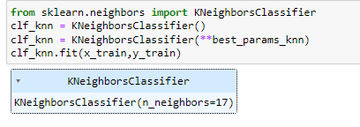
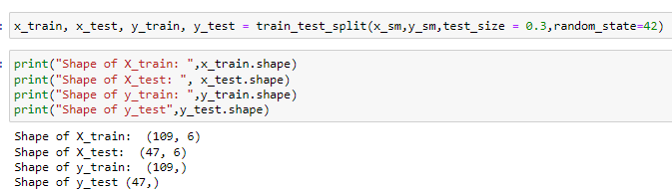
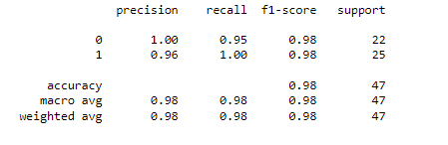
Model 2 – K-Nearest Neighbors (KNN)
SMOTE Balancing Technique
Grid Search CV for finding the optimal parameter
Model Algorithm with Best parameter
Data split
Classification Report

Slide 18
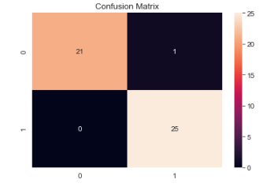
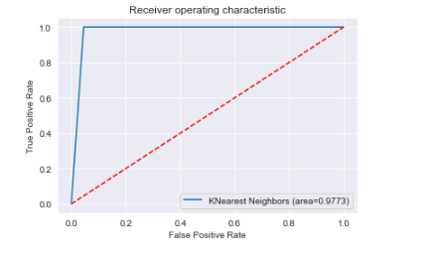
Model 2 – K-Nearest Neighbors (KNN)
Confusion Matrix
ROC & AUC curve for the model

Slide 19
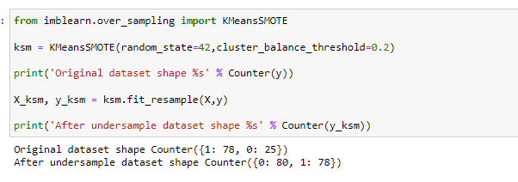
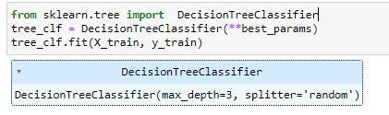
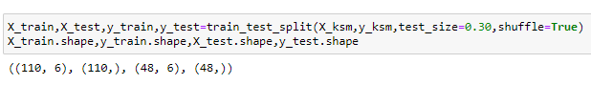
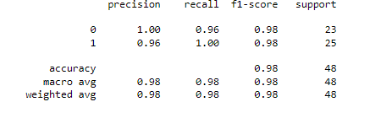
Model 3 – Decision Tree
Grid Search CV for finding the optimal parameter
K-means Smote Sampling
Model Algorithm with Best parameter
Data split
Classification Report

Slide 20
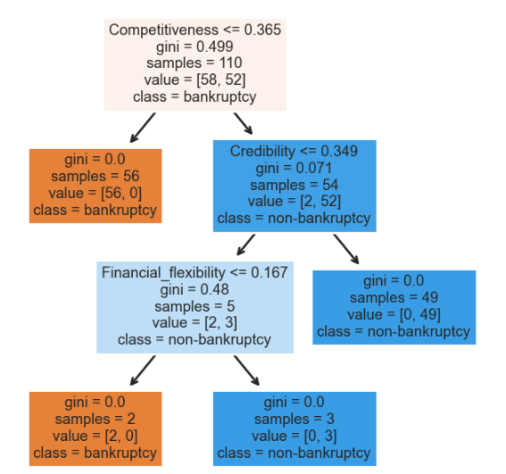
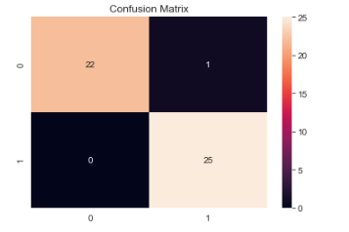
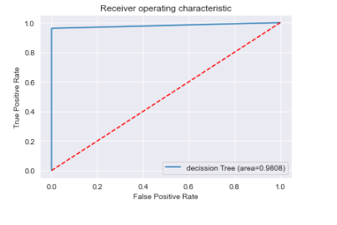
Model 3 - Decision Tree
Decision Tree
Confusion Matrix
ROC & AUC curve for the model

Slide 21
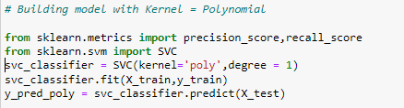
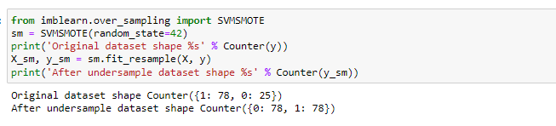
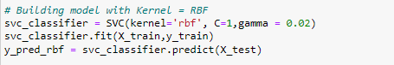
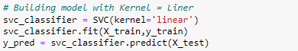
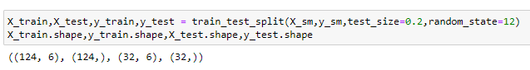
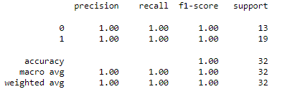
Model 4 – Support Vector Machine(SVM)
SVM-Smote Sampling
Model Algorithm with different Kernels
Data split
Classification Report

Slide 22
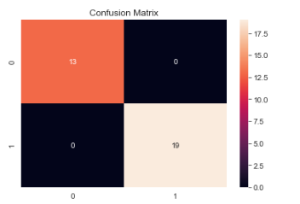
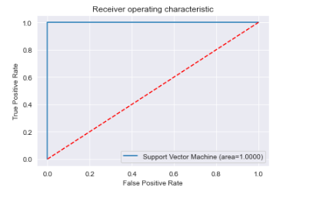
Model 4 – Support Vector Machine(SVM)
Confusion Matrix
ROC & AUC curve for the model

Slide 23
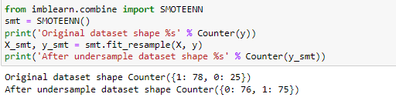




Model 5 – Random Forest
Smoteen Balancing
Randomized SearchCV
Data split
Model Algorithm with Best Parameter
Classification Report

Slide 24


Model 5 – Random Forest
Confusion Matrix
ROC & AUC curve for the model

Slide 25




Model 6 – ADABOOST
Data split
Model Algorithm with Best Parameter
Classification Report

Slide 26


Model 6 – ADABOOST
Confusion Matrix
ROC & AUC curve for the model

Slide 27
Final Model
ADA Boosting Model
is our final model as it is consistently giving
good accuracy.

Slide 28

Model Predictions
Transaction data fed to the model
Predicted probabilities for each transaction

Slide 29

Model Results
Model generated the output for business case data set in which 17 business cases are Bankrupted (0) and 14 business cases are Non-Bankrupted (1)

Slide 30

Final Model UI After Deployment

Slide 31


